Slide 1
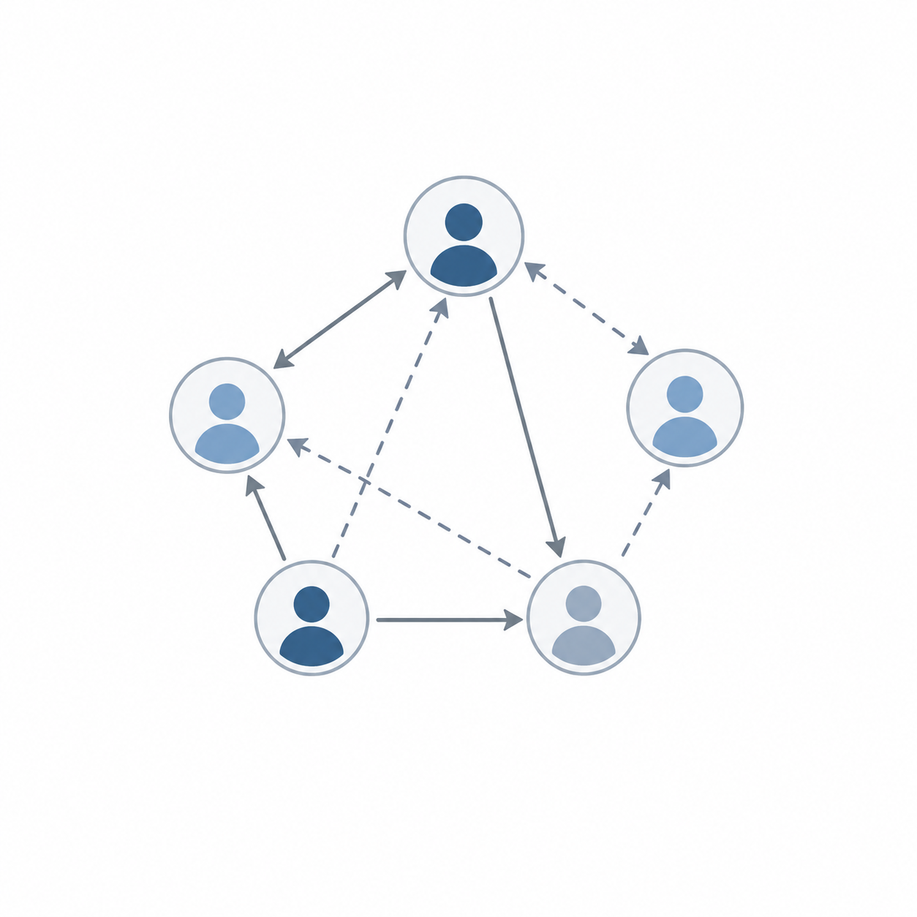
ABM Based Economics
L1: Intro & Motivation
Dr. Asad Zaman
Al-Nafi International

Slide 2
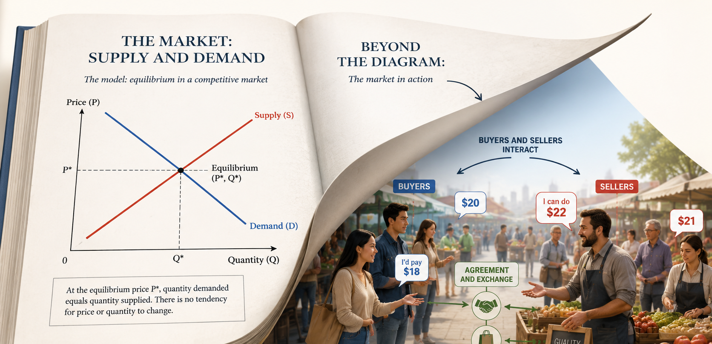
Supply and Demand as a Market Process:
Seeing Beneath the Diagram

Slide 3
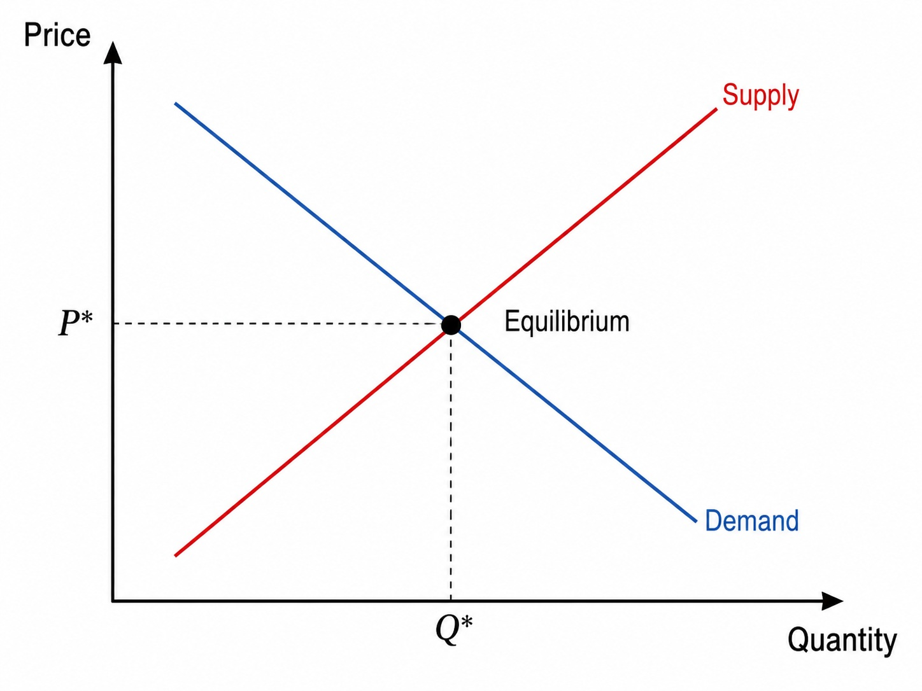
The Most Famous Picture in Economics

Slide 4
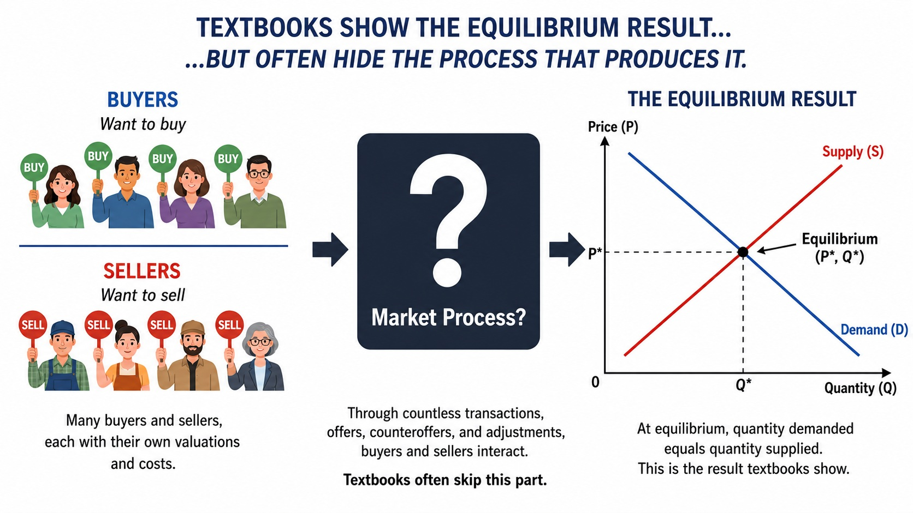
The Puzzle
The diagram shows the result: Equilibrium
But how does the market get there?

Slide 5
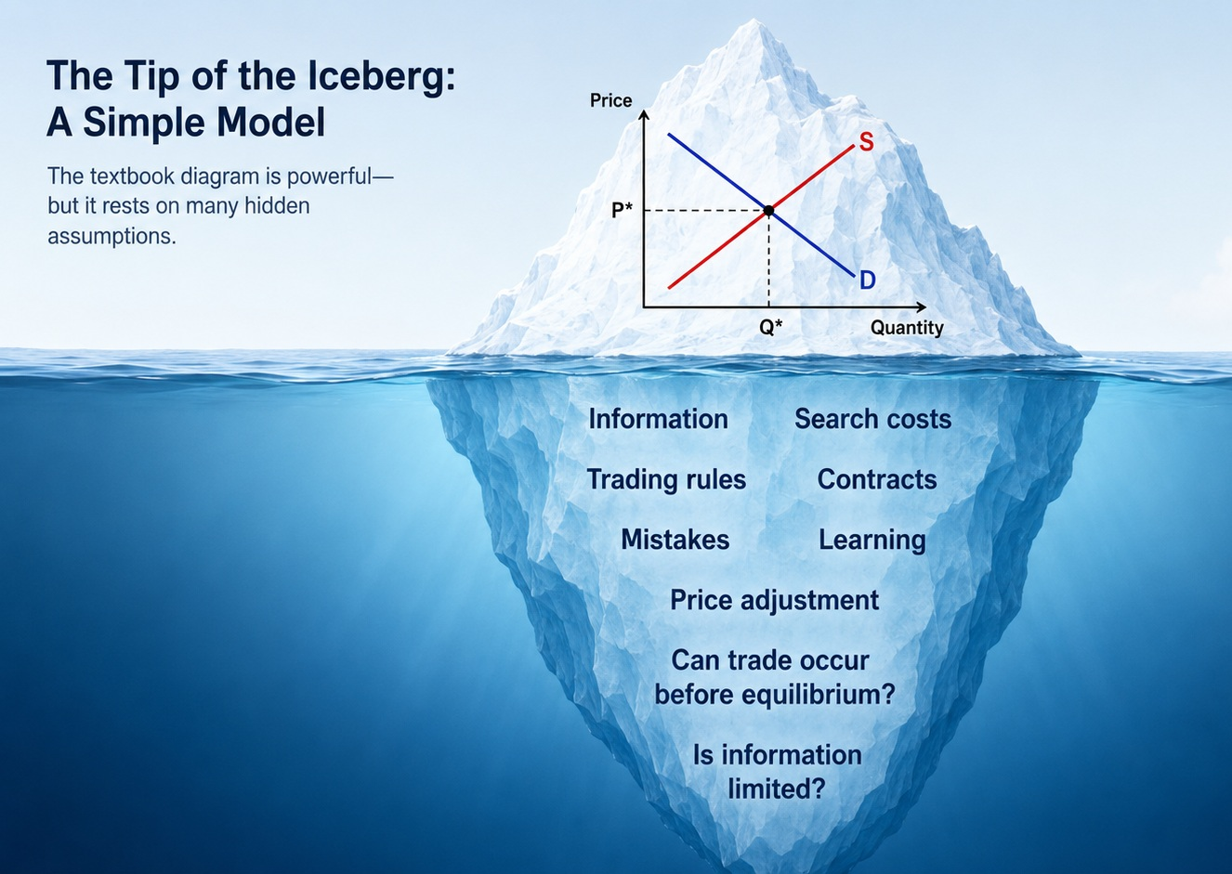
Questions Hidden Behind the Diagram
Who changes the price?
What do buyers and sellers know?
Can trade occur before equilibrium?
What happens if agents make mistakes?
Can contracts be undone?
Is search costly?
Is information limited?

Slide 6
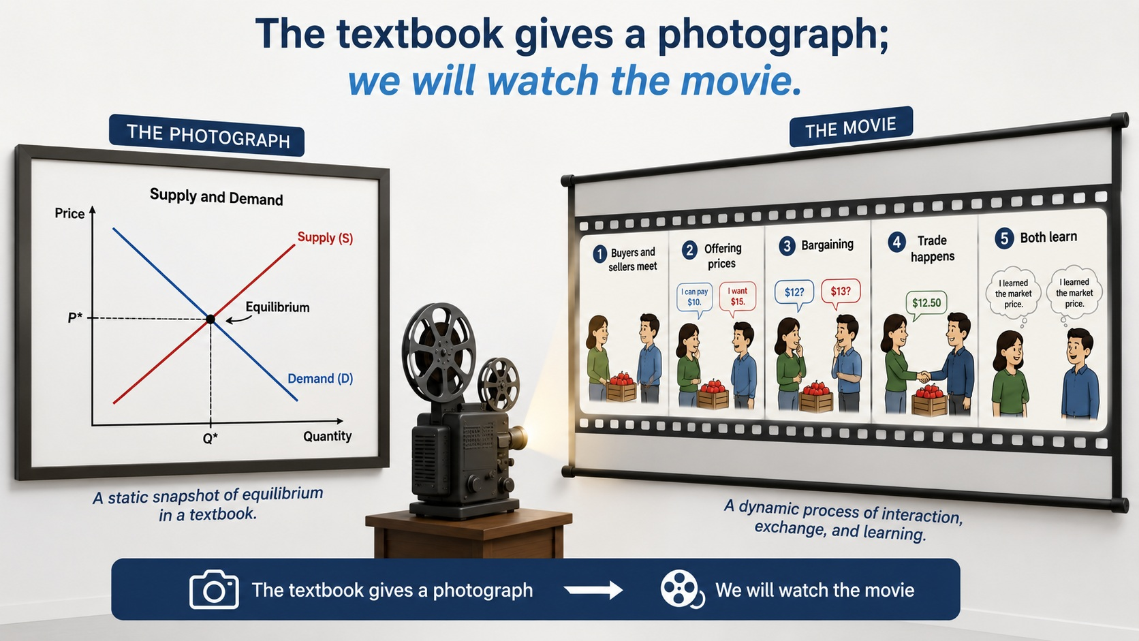

Slide 7
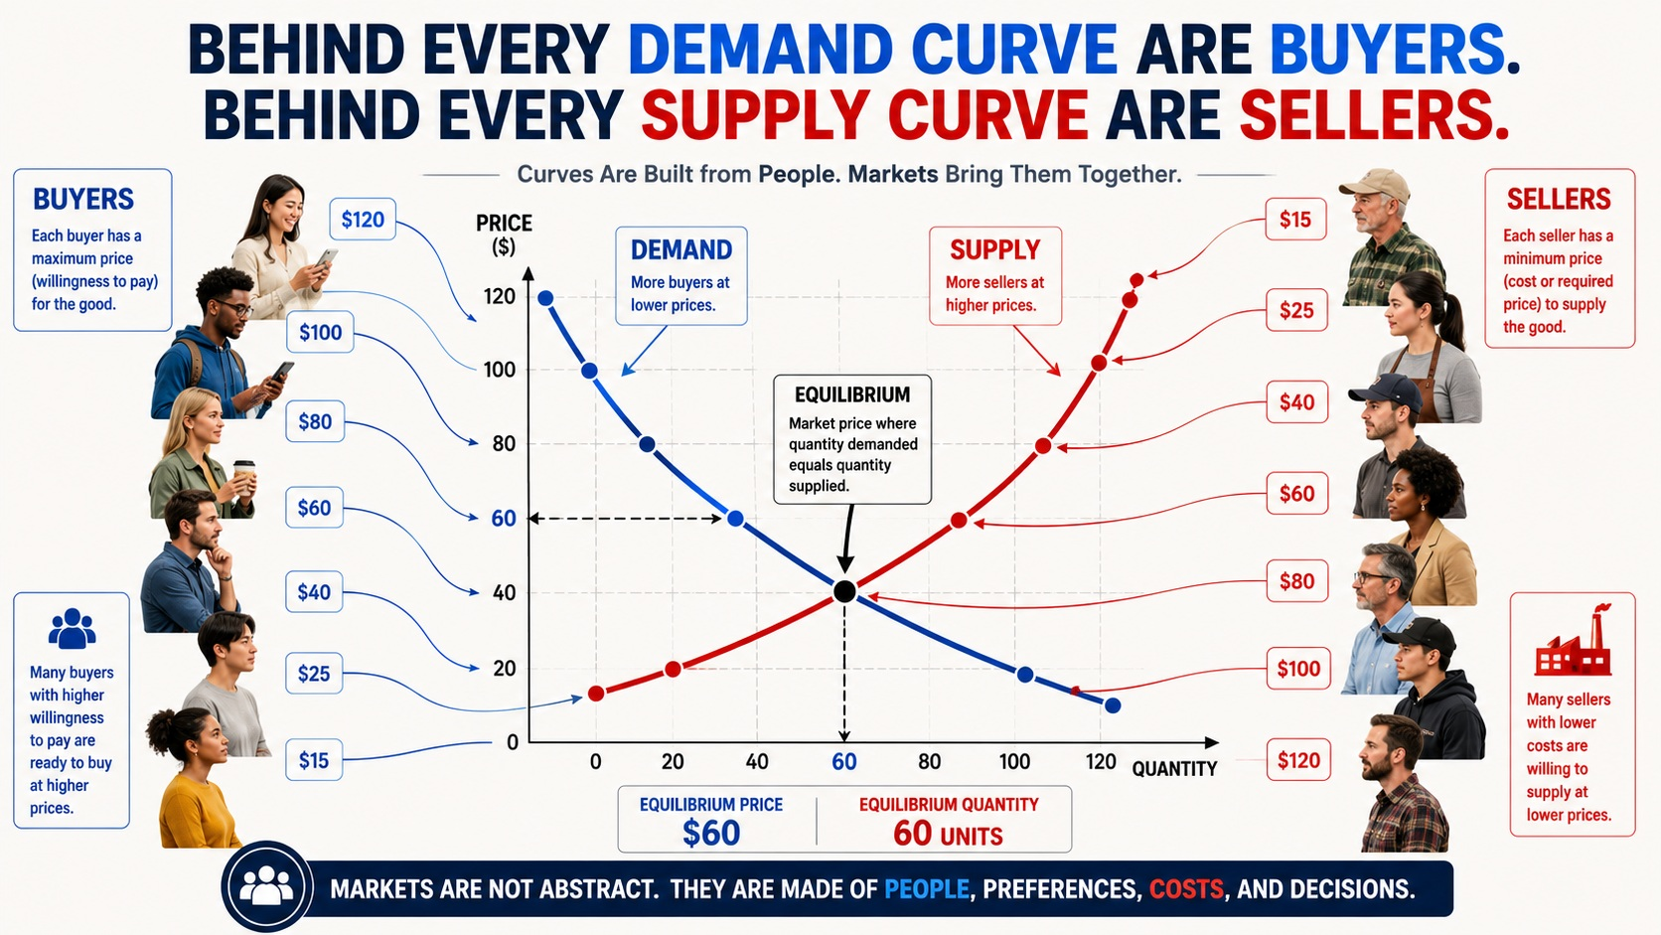

Slide 8
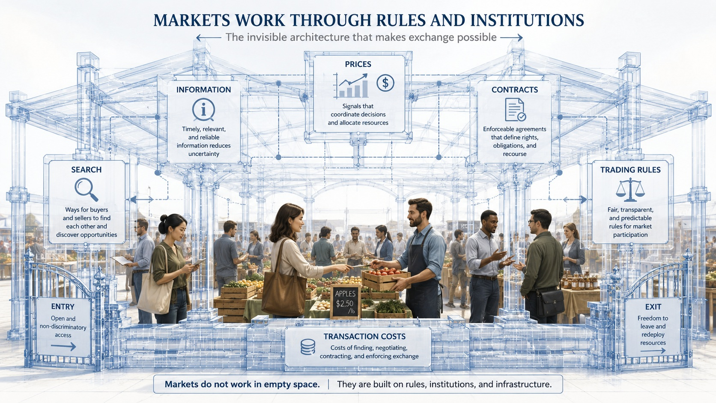

Slide 9

What You Will Learn:
By the end of this unit, you will understand:
how demand and supply curves are built from agents;
how equilibrium is defined;
why equilibrium requires a trading process;
why information matters;
why transaction costs matter;
why contracts matter;
why market outcomes depend on institutional rules.

Slide 10
Our Method: Build the Market Step by Step
We begin with buyers and sellers, not curves.
Buyers have maximum prices.
Sellers have minimum prices.
They meet, make offers, trade, and learn.
Using simple tables and Excel, we will see how market outcomes emerge.
Simple models. Clear understanding.

Slide 11

See Supply and Demand more clearly

Slide 12
Test Your Understanding:
Write Down the Answers to the Following Two Questions:
What does the supply-and-demand diagram explain?
What does it leave unexplained?
PAUSE the video to think, before going on.

Slide 13
Roadmap of the Unit
The basic supply-and-demand model
Demand and supply as summaries of agents
Equilibrium, shortage, and surplus
Price adjustment
Applications of the model
Agent-based reconstruction of the model
Market microstructure and hidden assumptions

Slide 14

Supply & Demand: A New Beginning
Textbook S&D: THE model to use for economic policy
ABM models – S&D provides a starting point.
Far more complex models, with far more realistic assumptions, can be analyzed.
Results we get are VERY DIFFERENT from conventional textbooks.

Slide 15
Interested in following this course?
Teachers and students can sign up for updates, recordings, quizzes, and pilot materials:
bit.ly/ABMSD

